Slide 1
The Rössler System
Blair Ebeling
MATH441: Spring 2017

Slide 2
Creation of the Rössler System
Rössler systems were introduced in the 1970s by Otto Rössler as prototype equations with the minimum ingredients for continuous-time chaos.
The minimal dimensions for chaos is three so Rössler created prototype systems of ODEs in 3 dimensional phase spaces
Rössler used the reinjection principle to invent a series of system
Notes:
ODE – ordinary differential equations

Slide 3
Series of Rössler Systems
The most famous system that he invented is
with the term xz being the only nonlinear term.

Slide 4
Why is this system minimal?
Its phase space has the dimension three, which is the minimal dimension.
There is only one quadratic term, so its nonlinearity is minimal.
It generates a chaotic attracter with a single lobe, which is the minimal number of lobes an attracter can have.

Slide 5
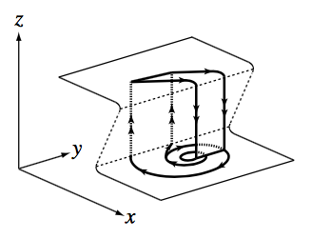
Reinjection Principle
Based on the feature of “relaxation” type systems that often present a Z-shaped slow manifold in their phase space
Notes:
In dimension three

Slide 6
Motion of the Rössler System
The linear terms of the first two equations create oscillations in the variables x and y and can be amplified when a>0, resulting in a spiraling-out motion.
This motion is coupled with the z variable in the third equation to generate the reinjection back to the beginning of the spiraling-out motion.

Slide 7
Fixed Points of the System
To find the fixed points, we set the three equations equal to zero and solve the resulting equations.
This yields the fixed points for a given set of parameter values (a, b, c):

Slide 8
Eigenvalues and Eigenvectors
The stability of each of the fixed points can be analyzed by determining the eigenvalues and eigenvectors.
We start with the Jacobian:
We can then solve for the eigenvalues to get:

Slide 9
Chaotic Attractor
The behavior of the Rössler system is chaotic for certain value ranges of the three parameters (a, b, c).
The values originally studied by Rössler were a=0.2, b=0.2, and c=5.7, which creates the chaotic attractor.
We will use these values to plug into the fixed points and eigenvalue equation.

Slide 10
Fixed Points of the Chaotic Attractor
Plugging in a=0.2, b=0.2, and c=5.7, the fixed points are:
and

Slide 11
Eigenvalues of the Chaotic Attractor
The first fixed point, (5.69,-28.46,28.46), is known as the centrally located fixed point. We will call this FP₁
Plugging in the same parameter values and the centrally located fixed point, we get:

Slide 12
Eigenvectors of the Chaotic Attractor
The eigenvectors corresponding to the eigenvalues of the centrally located fixed point are:

Slide 13
Eigenvalues of the Chaotic Attractor
The second fixed point, (0.007,-0.035,0.035), is known as the outlier fixed point. We will call this FP₂
Plugging in the same parameter values and the outlier fixed point, we get:

Slide 14
Eigenvectors of the Chaotic Attractor
The eigenvectors corresponding to the eigenvalues of the outlier fixed point are:

Slide 15
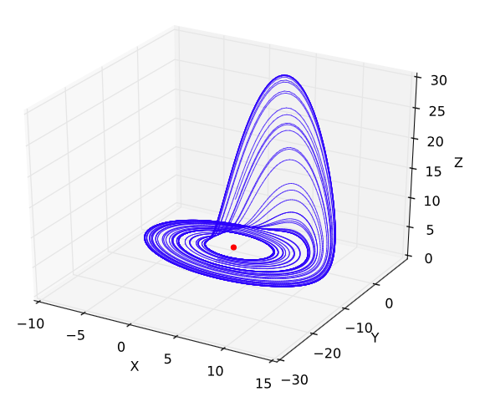
Resulting Phase Space
This figure is the Rössler attractor with a=0.2, b=0.2, and c=5.7
The red dot in the center of this attractor is FP₁

Slide 16
Conclusion
The Rössler System is important because it was later found to be useful in modeling equilibrium in chemical reactions.
We also care about this because it allows us to describe the attractors of chaotic dynamical systems, which has been one of the achievements of chaos theory.

