Slide 1
Ergodic Theory and Statistical Mechanics
Reid Calamita

Slide 2
Motivation: Why Dynamics?
Modeling motion through time
Analytical Solutions
Numerical Approximations
Qualitative Results
Fixed Points
Robustness
General Behavior
Bounds
Limit Cycles

Slide 3
Motivation: Chaos
Chaotic systems are very difficult
No analytic solutions
Numerical approximations of limited use
Strange Attractors
How to derive information about such systems?

Slide 4
Example: Thermodynamics
The Problem: Molecules in a closed box
Want position, momentum of each molecule
Technically deterministic, but…
HUGE number of molecules
Initial conditions difficult to measure (Heisenberg)
Solving Analytically: Impossible
Solving Numerically: Comically Expensive
What Now?

Slide 5
Demonstration
http://www.falstad.com/gas/

Slide 6
Maxwell, Boltzmann
Sought to describe systems as in our example
Developed field of Statistical Mechanics
Assumed Ergodic Hypothesis
Justified assumption by experimental evidence
Went unproven until 1931

Slide 7
Ergodicity
Intuition: A system is ergodic if its long-term behavior behaves almost independently of initial conditions.
Common example: Markov Chains
$P\left(x_{n} \right|{ x}_{0},x_{1},x_{2}, …,x_{n−1})=P(x_{n} |x_{n−1})$
Eliminates many common solutions (Limit cycles, fixed points, etc.)

Slide 8
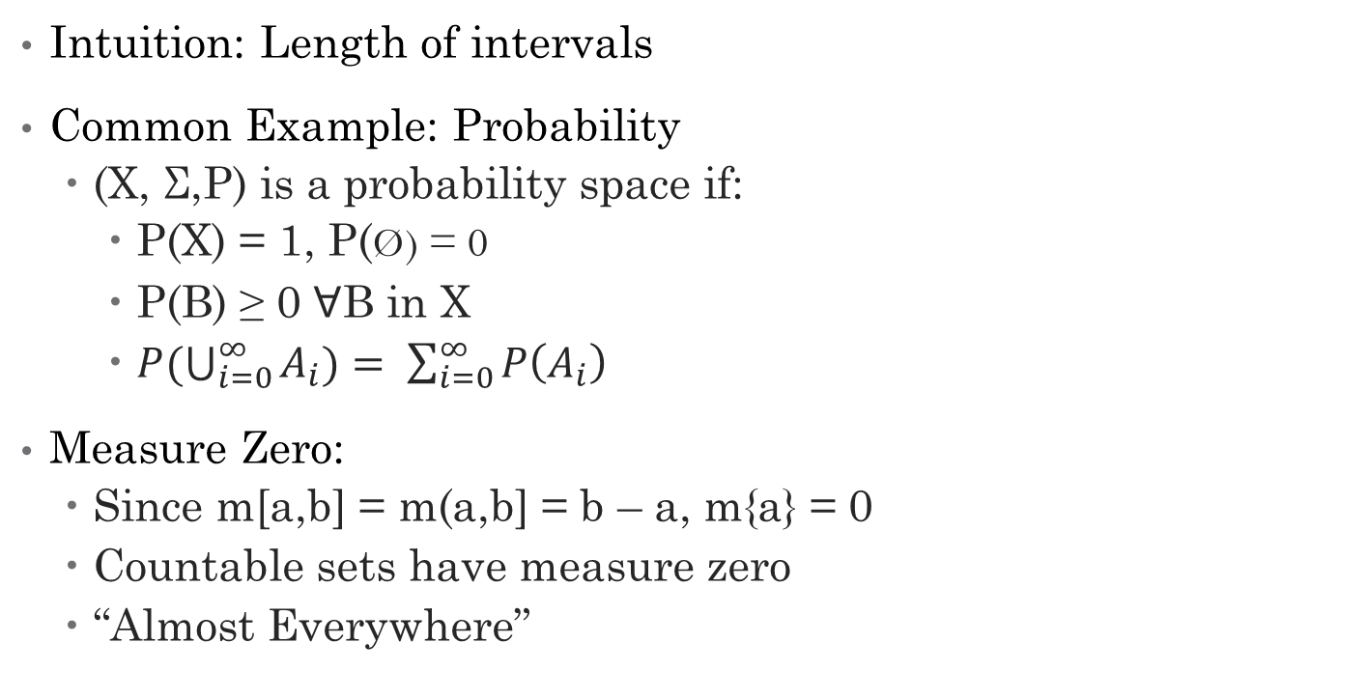
Detour: Measure Theory
Intuition: Length of intervals
Common Example: Probability
(X, Σ,P) is a probability space if:
P(X) = 1, P(Ø) = 0
P(B) ≥ 0 ꓯB in X
$P(\bigcup_{i=0}^{∞}{A_{i})= \sum_{i=0}^{∞}{P\left(A_{i}\right)}}$
Measure Zero:
Since m[a,b] = m(a,b] = b – a, m{a} = 0
Countable sets have measure zero
“Almost Everywhere”

Slide 9
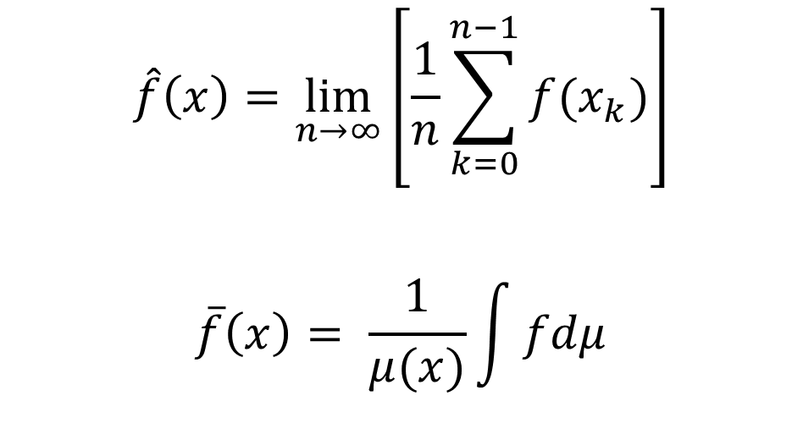
Ergodic Hypothesis Definitions
$$\hat{f}\left(x\right)=\lim_{n→∞}\left[\frac{1}{n}\sum_{k=0}^{n−1}{f(x_{k})}\right]$$
$$\overline{f}\left(x\right)= \frac{1}{μ(x)}\int{fdμ}$$
Time Average:
Space Average:
Two functions f and g are equal Almost Everywhere (A.E.) if:
$$μ\left\{x | f\left(x\right)≠g\left(x\right)\right\}=0$$

Slide 10
Ergodic Hypothesis
If f is integrable and 𝜇 is a time-invariant measure, then $\hat{f}\left(x\right)=\overline{f}\left(x\right)$, i.e.
$$\lim_{n→∞}\left[\frac{1}{n}\sum_{k=0}^{n−1}{f(x_{k})}\right]= \frac{1}{μ(x)}\int{fdμ},$$
almost everywhere.

Slide 11
Why does this help?
Let f(x) be the velocity of a gas particle at x.
Suppose we want average velocity of particles in gas cloud $A=\bigcup{x_{i} }$ at time t.
By Ergodic Theorem, this is almost surely equal to time average of one particle’s trajectory.
Far simpler task computationally
Works both ways
Allows us to estimate long-run behavior with cross-section

Slide 12
Further Implications
Liouville Theorem: Phase space density of a given set of solutions is constant in time
Poincaré recurrence theorem: After sufficiently long time, any dynamical system with invariant measure will return arbitrarily close to initial conditions

Slide 13
Did this further dynamics?
Recall that we wanted:
Analytical solutions, or if impossible,
Numerical solutions, or if impossible,
Qualitative behavior
Still no analytical solution, for the most part
We do get numerical and qualitative behavior.

Slide 14
Questions?

Slide 15
Works Cited
Moore, Calvin C.: Ergodic theorem, ergodic theory, and statistical mechanics. PNAS 2015 112 (7) 1907-1911
Gray, R.M.: Probability, random processes, and ergodic properties. Springer, Boston (2009).
Claude-Alain Pillet. : The Hamiltonian Approach. S. Attal, A. Joye, C.-A. Pillet. Open Quantum Systems I, 1880, Springer, pp.107-182, 2006

