Slide 1
Difference Between Chaos and Randomness
Qihuang Jiang
MATH 411

Slide 2
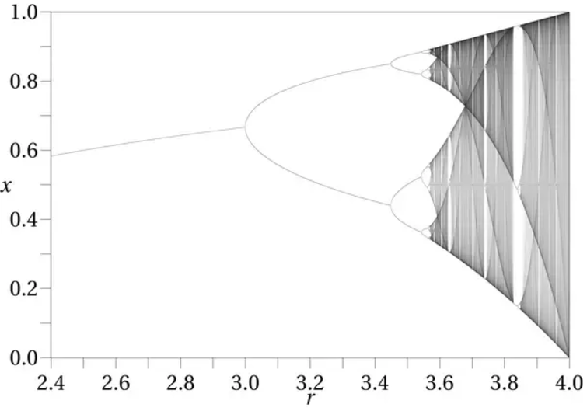
Chaotic systems
logistic map

Slide 3
Random Systems
Randomness is the lack of pattern or predictability in events. A random sequence of events, symbols or steps has no order and does not follow an intelligible pattern or combination.
Individual random events are by definition unpredictable, but in many cases the frequency of different outcomes over a large number of events (or "trials") is predictable. For example, when throwing two dice, the outcome of any particular roll is unpredictable, but a sum of 7 will occur twice as often as 4.

Slide 4
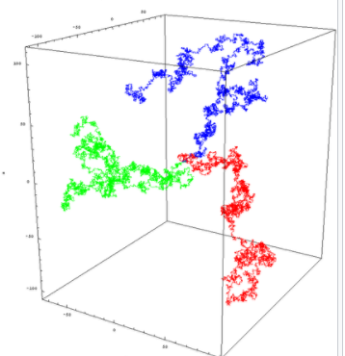
Random Walk
Random walk in two dimensions with 25 thousand steps
Three random walks in three dimensions

Slide 5
Distinguishing Chaos from Randomness
ten thousand coin tosses
(1 is heads, 0 is tails)
[1 1 1 1 1 1 1 1 1 1] appears at least fourth
[1 0 1 0 1 0 1 0 1 0 1 0 1 0] appears at least twice
[1 1 0 1 1 0 0 1 1 1 0 1 1 0] it is actually calculated deterministically from the dynamics of a chaotic system

Slide 6
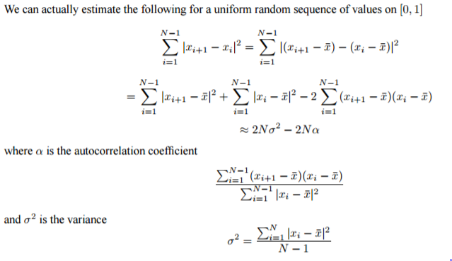
Furthermore

Slide 7
generally speaking…
Chaos is based on the idea that minute differences in your starting condition can magnify into large results. Every step along the way can be perfectly predicted if you have enough precision, but the longer it runs the more any imprecision magnifies.
A random process has an outcome which is independent of the inputs. Even with perfect knowledge, you can't predict an outcome.

Slide 8
References
1.Paul Glendinning, "Stability, Instability and Chaos", Cambridge University Press, 1994. 2.Steven Strogatz, "Non-linear Dynamics and Chaos: With applications to Physics, Biology, Chemistry and Engineering", Perseus Books, 2000.
2.“chaos_vs_random”,http://www.math.tamu.edu/~mpilant/math614/chaos_vs_random.pdf
3. Blank, S., (1991), “Chaos In Futures Markets? A Nonlinear Dynamical Analysis”, Journal of Futures Markets, 11, 711–728.
4. A. G. Malliaris, G. Philippatos,” Random Walk vs. Chaotic Dynamics in Financial Economics”
5.Aldous, David; Fill, Jim, Reversible Markov Chains and Random Walks on Graphs, http://stat-www.berkeley.edu/users/aldous/RWG/book.html

